Slide 1
Artificial intelligence
Session – 3
Date – 15th May, 2022

Slide 2
Python numpy Aggregate Functions
In the Python numpy module, we have many aggregate functions or statistical functions to work with a single-dimensional or multi-dimensional array. The Python numpy aggregate functions are sum, min, max, mean, average, product, median, standard deviation, variance, argmin, argmax, percentile, cumprod, cumsum, and corrcoef.

Slide 3
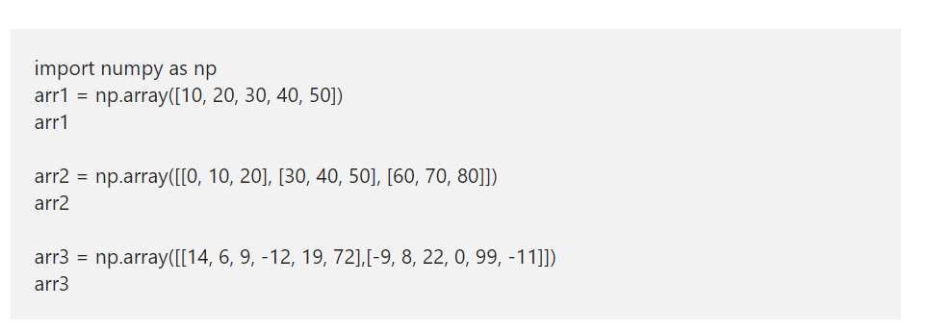
Python numpy Aggregate Functions
To demonstrate these Python numpy aggregate functions, we use the below-shown arrays.

Slide 4
Python numpy sum
Python numpy sum function calculates the sum of values in an array.
Ex – arr1.sum()
This Python numpy sum function allows you to use an optional argument called an axis. This Python numpy Aggregate Function helps to calculate the sum of a given axis. For example, axis = 0 returns the sum of each column in an Numpy array. axis = 1 returns the sum of each row in an array
Ex – arr2.sum(axis = 0)

Slide 5
Python numpy average
Python numpy average function returns the average of a given array.
Ex – np.average(arr1)
Average of x and Y axis
Ex- np.average(arr1, axis = 0)

Slide 6
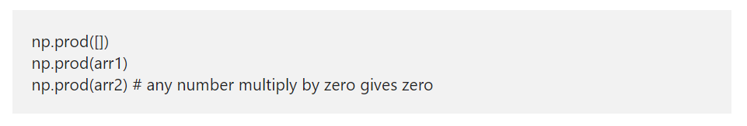
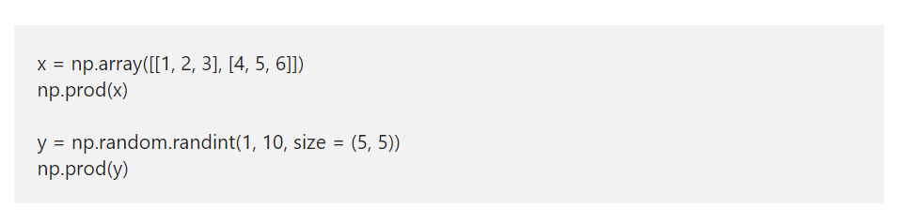
Python numpy prod
Python numpy prod function finds the product of all the elements in a given array. This numpy prod function returns 1 for an empty array

Slide 7
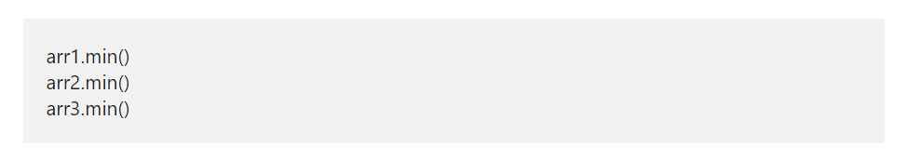
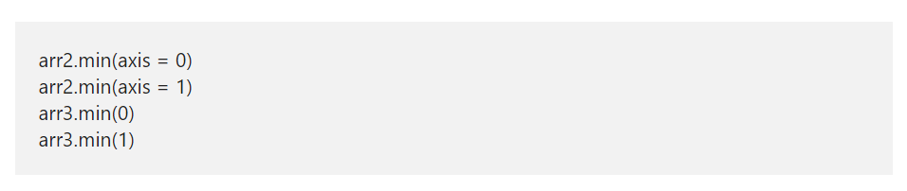
Python numpy min
The Python numpymin function returns the minimum value in an array or a given axis.

Slide 8
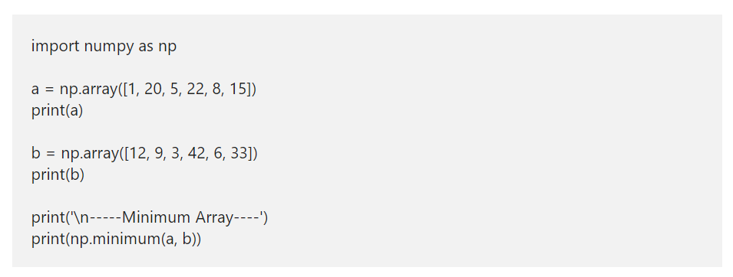
Python Array minimum

Slide 9
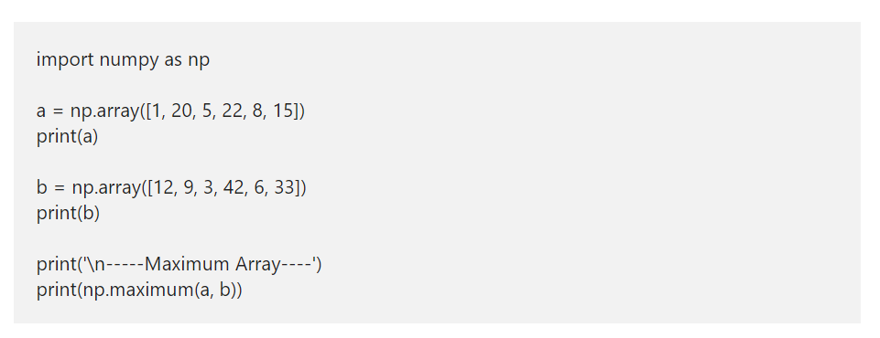
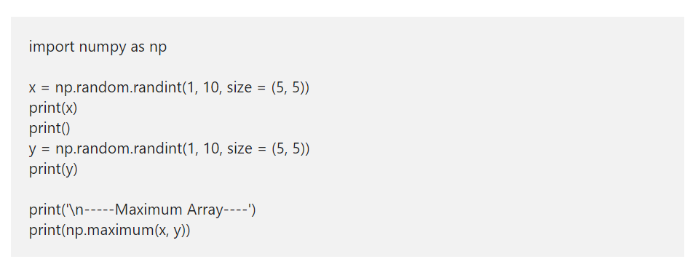
Python numpy Array maximum

Slide 10
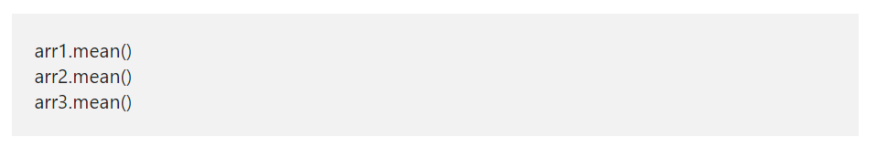
Python numpy mean
Python numpy mean function returns the mean or average of a given array or in a given axis. The mathematical formula for this numpy mean is the sum of all the items in an array / total array of elements.

Slide 11
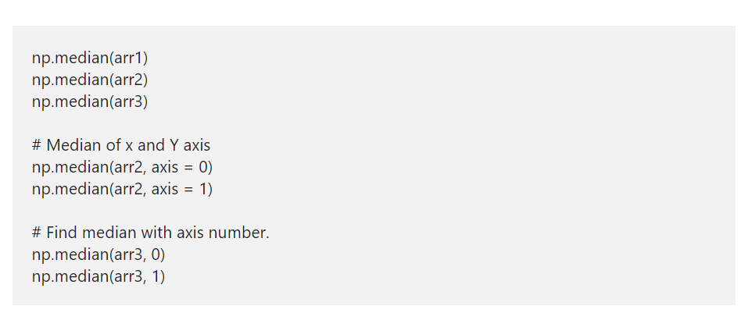
Python numpy median

Slide 12
Python numpy Arithmetic Operations
Python numpy module provides various arithmetic functions such as add, subtract, multiply and divide, which performs Python numpy arithmetic operations on arrays. Apart from them, you can use the standard Python Arithmetic Operators also. Arrays should be of the same shape, or they have to bound to array rules to use numpy arithmetic functions.
We use the below arrays to demonstrate the Python numpy Arithmetic Operations using arithmetic functions and arithmetic operators

Slide 13
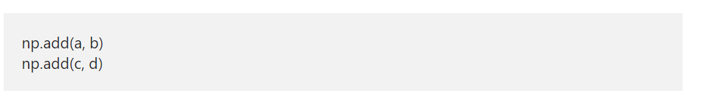
Python numpy add function

Slide 14
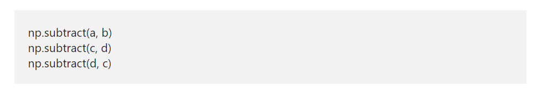
Python numpy subtract function

Slide 15
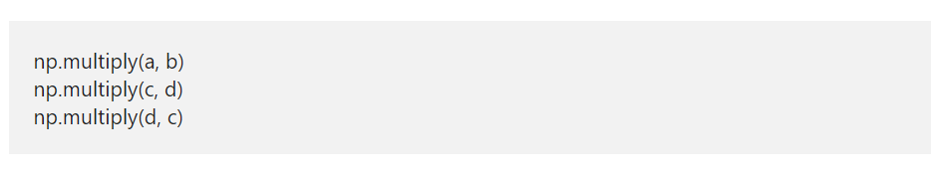
Python numpy multiply function

Slide 16
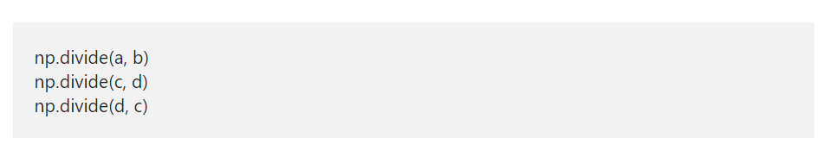
Python numpy divide function

Slide 17
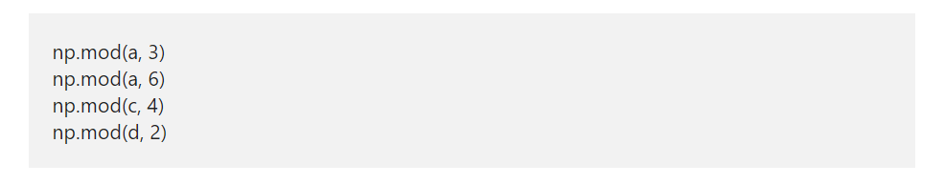
Python numpy mod function
The Python numpy mod function returns the remainder of the division.

Slide 18
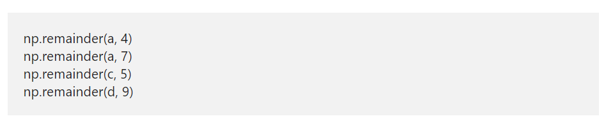
Python numpy remainder function
Similar to mod function, the Python numpy reminder function returns the remainder of the arithmetic division.

Slide 19
Python numpy Comparison Operators
The Python numpy comparison operators and functions used to compare the array items and returns Boolean True or false. The Python Numpy comparison functions are greater, greater_equal, less, less_equal, equal, and not_equal. Like any other, Python Numpy comparison operators are <, <=, >, >=, == and !=
To demonstrate these Python numpy comparison operators and functions, we used the numpy random randint function to generate random two dimensional and three-dimensional integer arrays.
The first array generates a two-dimensional array of size 5 rows and 8 columns, and the values are between 10 and 50.

Slide 20
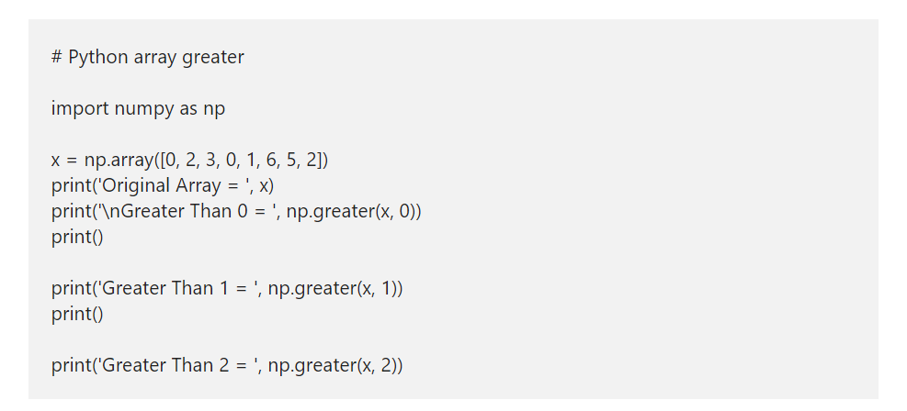
Python numpy Array greater/greater_equal/less/less_equal/equal/ not_equal
It is a simple Python Numpy Comparison Operators example to demonstrate the Python Numpy greater function. First, we declared an array of random elements. Next, we are checking whether the elements in an array are greater than 0, greater than 1 and 2. If True, True returned otherwise, False returned.

Slide 21
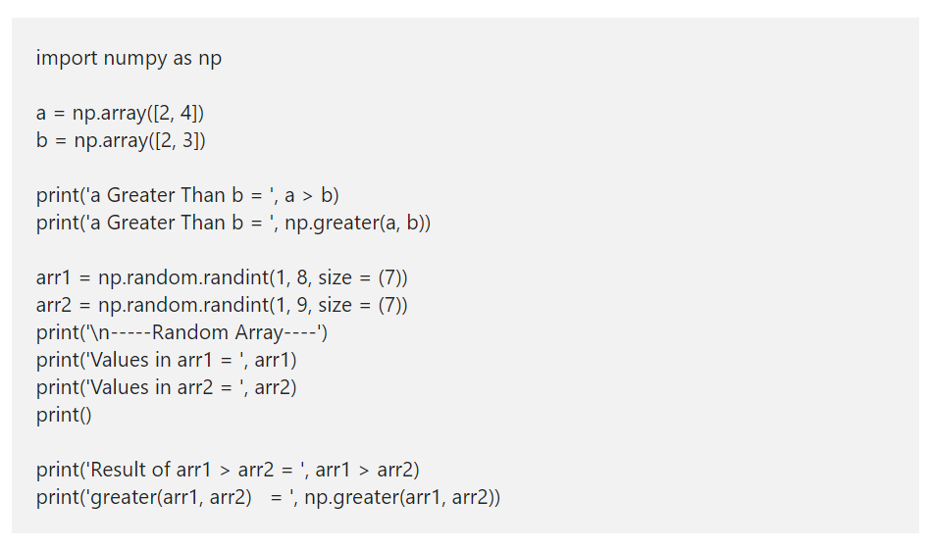
>,>=,<,<=,==,!= Operator
The Python Numpy > Operator is the same as a greater function. Either you can use this to compare each element in an array with a static value, or use this to compare two arrays or matrixes.

Slide 22
Python Numpy alltrue and sometrue functions
The Python Numpy alltrue function is similar to the If statement. If the condition inside this function is true, then True returned otherwise, False. For example, np.alltrue(np.greater(x, 2)) – It returns True if all the elements in x array are greater than 2, then True returned; otherwise, this function return False.
The Python Numpy sometrue function returns true if at least one element in the specified array has to meet the condition otherwise, False. For example, np.alltrue(np.less(x, 3)) – It returns True if at least one element or one array item is less than 3 otherwise, this function return False.

Slide 23
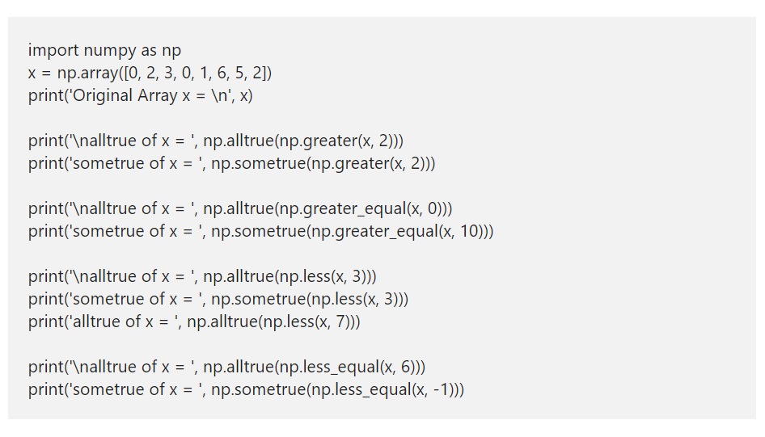

Slide 24
Python random array
In Python, we have the random module used to generate random numbers of a given type using the PRNG algorithm. Here, we are going to discuss the list of available functions to generate a random array in Python.
A pseudorandom number generator (PRNG), also known as a deterministic random bit generator (DRBG),[1] is an algorithm for generating a sequence of numbers whose properties approximate the properties of sequences of random numbers.

Slide 25
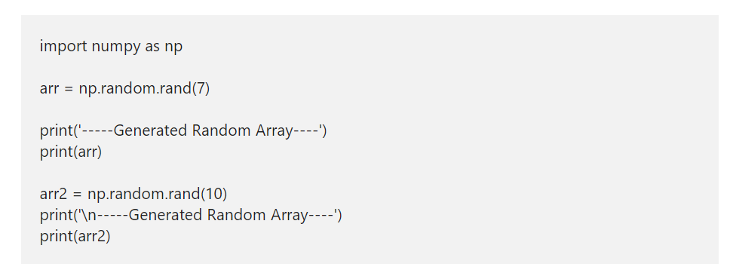
Python random array using rand
The Numpy random rand function creates an array of random numbers from 0 to 1. Here, you have to specify the shape of an array.

Slide 26
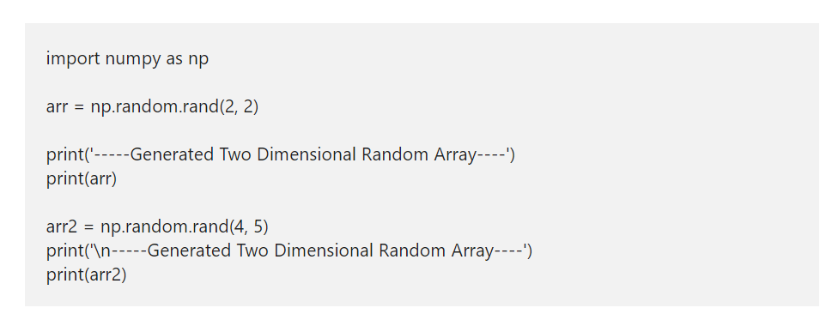
Python numpy 2D Random Array

Slide 27
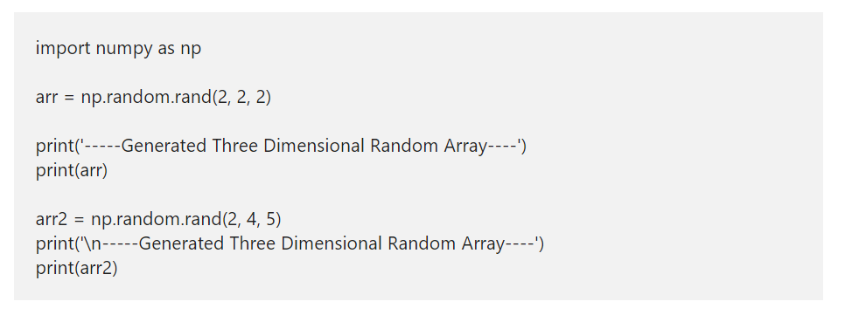
Python Numpy 3D Random Array

Slide 28
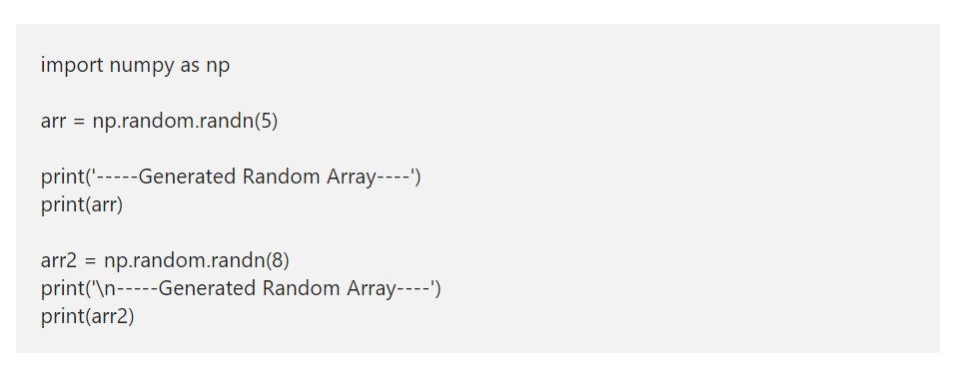
Python numpy random randn

Slide 29
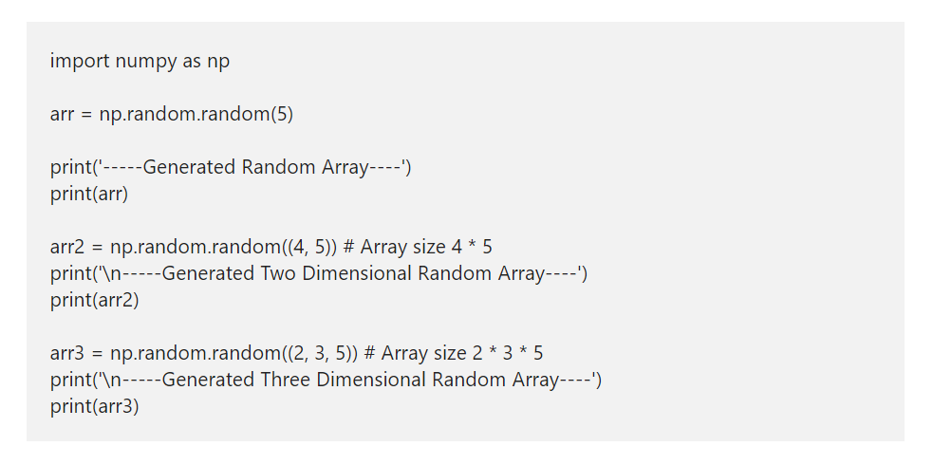
numpy Array using random function

Slide 30
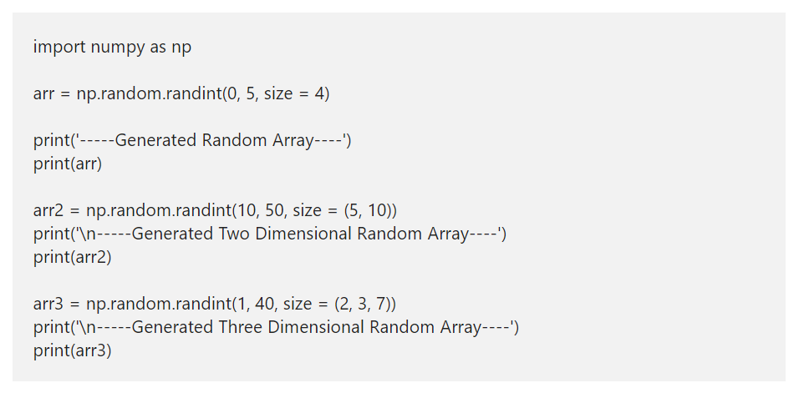
Python Numpy random randint
The Numpy random randint function returns an integer array from low value to high value of given size. The syntax of this Numpy function in Python is.

Slide 31
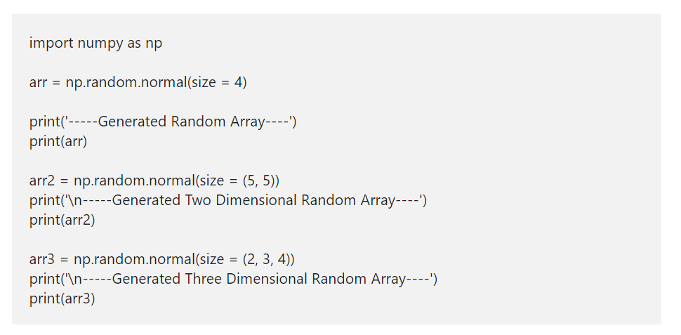
Python Numpy random normal
The Python Numpy random normal function generates numbers from a normal distribution. This Numpy normal accepts the size of an array then fills that array with normally distributed values.

Slide 32
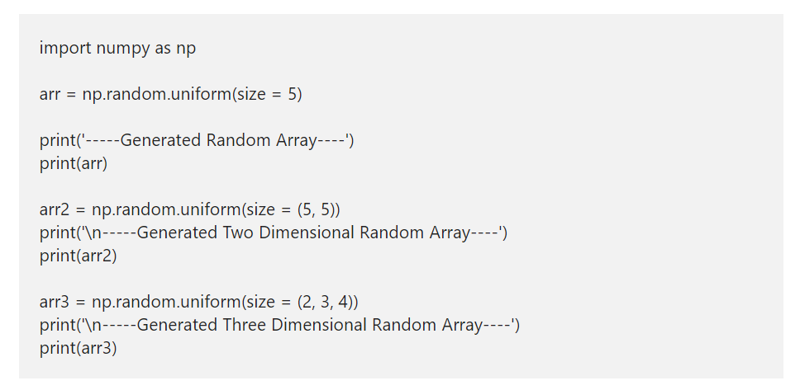
Python Numpy random uniform
The Python Numpy random uniform function generates a uniform distribution of numbers. This uniform accepts the array size and fills that array with uniform distributed values.

Slide 33
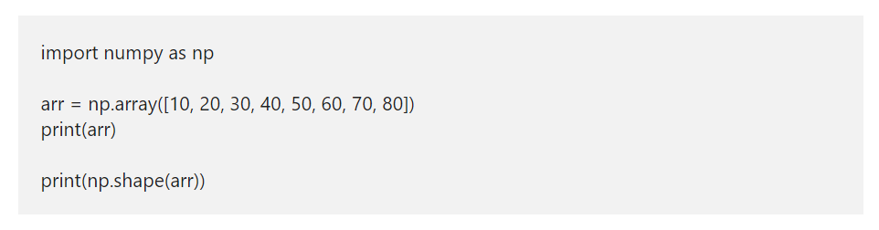
Python numpy Array shape
The Python numpy module has a shape function, which helps us to find the shape or size of an array or matrix. Apart from this shape function, the Python numpy module has reshape, resize, transpose, swapaxes, flatten, ravel, and squeeze functions to alter the matrix of an array to the required shape.

Slide 34
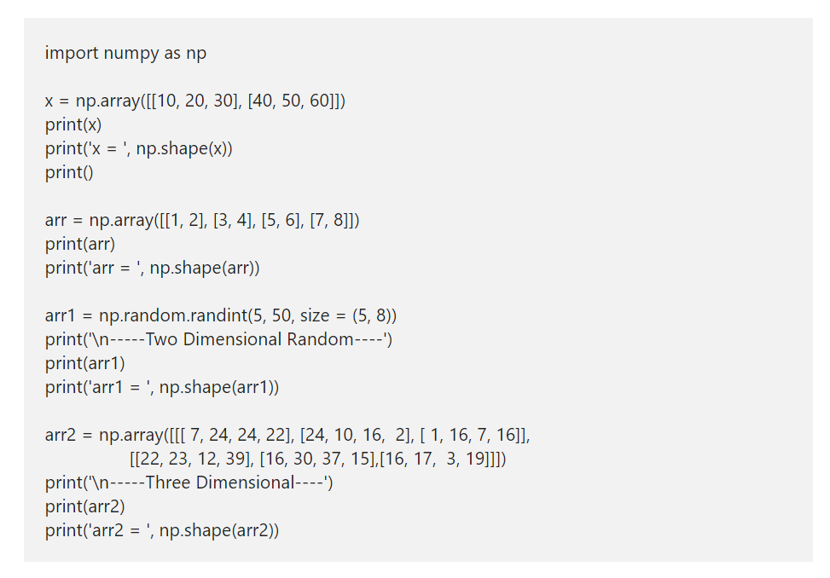

Slide 35
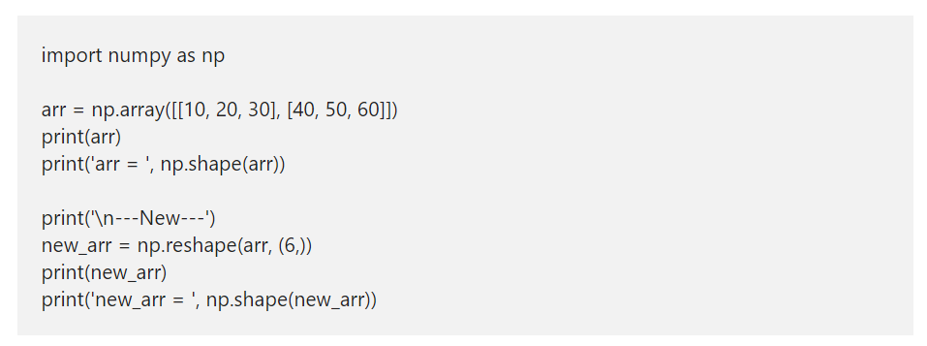
Python numpy Array reshape
The Numpy reshape function accepts an array as the first argument and shape or matrix size as the second argument.

Slide 36
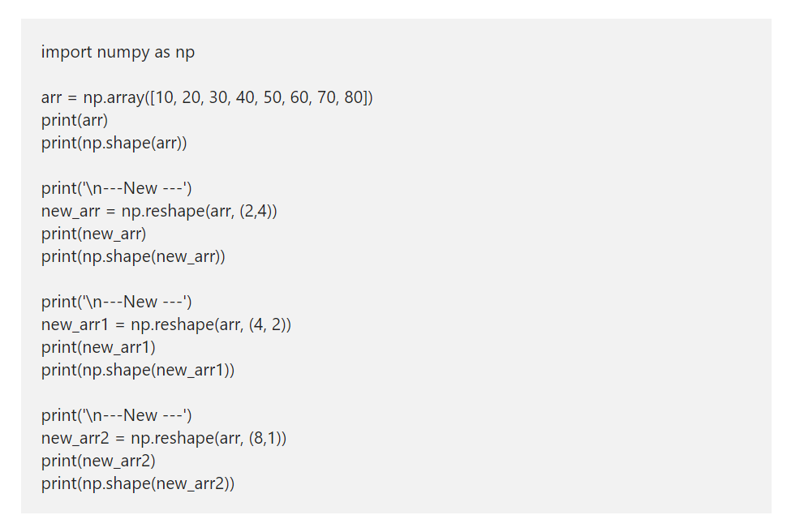

Slide 37
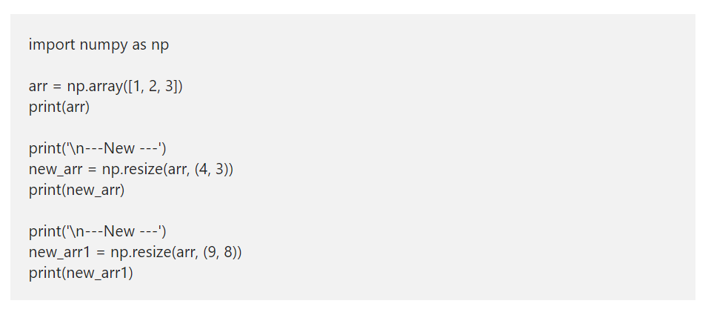
Python numpy Array resize
The Python resize function is useful to resize the existing numpy array to the desired shape. This function accepts an array as the first argument and the desired shape size as a second argument. If you specify the desired shape larger than the original, the Numpy array resize function replicates the values in the base array to create a big array.

Slide 38
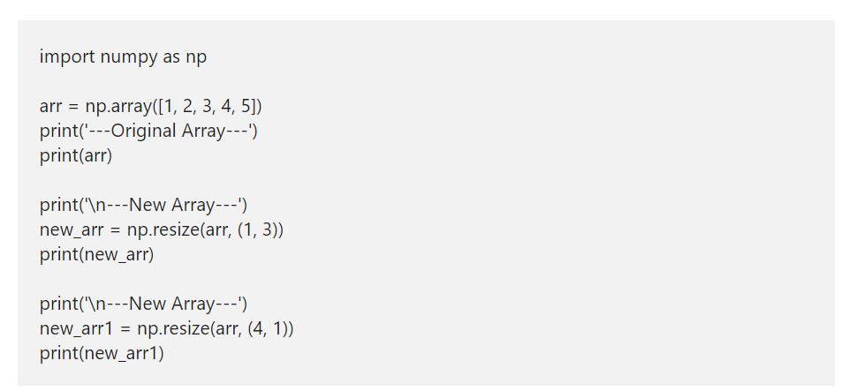

Slide 39
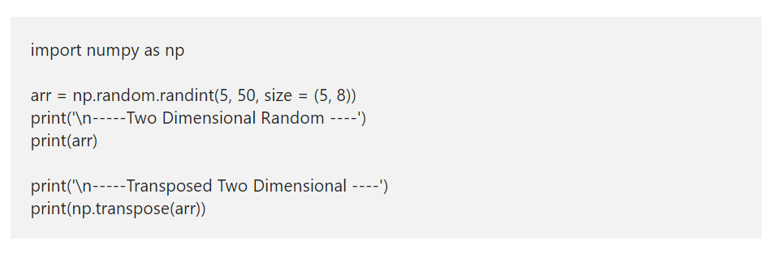
numpy transpose
The transpose function helps you to transpose the given matrix or 2D.

Slide 40
Python numpy Array flatten
The Python flatten function collapses the given array into a one-dimensional. This Python Numpy array flatten function accepts order parameters to decide the order of flattening items.
order = {C, F, A, K} – You can use one of them, or it considers C because it is the default one. C means items will flatten in row-major order. F means Fortran style or column major order. If the array is Fortran contiguous, A flattens in column major order otherwise, row-major order. K flattens in the order of elements occurred in memory.

Slide 41
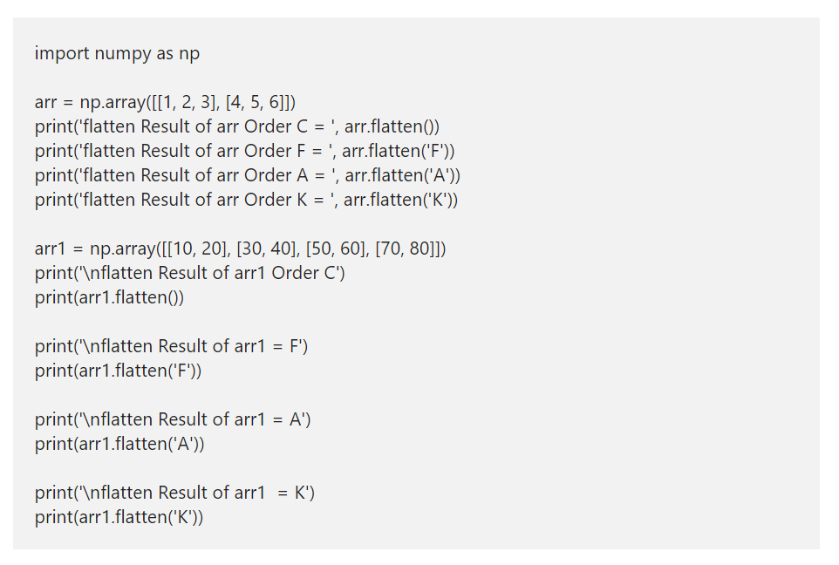

Slide 42
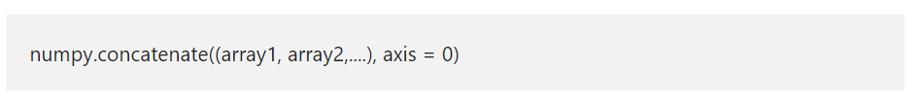
Python numpy concatenate
The Python numpy concatenate function used to Join two or more arrays together and returns the ndarray as an output. The syntax of the Python numpy concatenate function is
array1, array2,… are the arrays that you want to combine. The arrays that you pass to this function must have the same shape. However, you can choose the arrays with different dimensions.
axis – This is an optional argument with default value as 0. Use this to specify in which way (horizontal or Vertical) concatenation should be done.

Slide 43
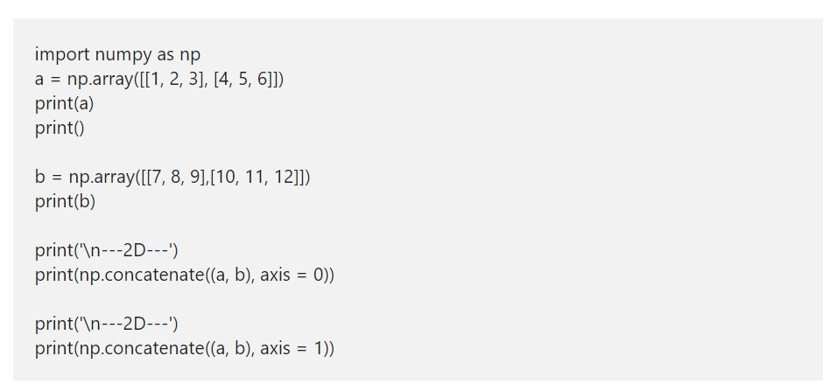
numpy concatenate 2D array with axis
Until now, we are using this method without an axis parameter. This time, we use this parameter value while combining two-dimensional arrays. Remember, If axis = 0, then the items in b are vertically appended to a. Whereas axis = 1 horizontally appends items in b to a.

Slide 44
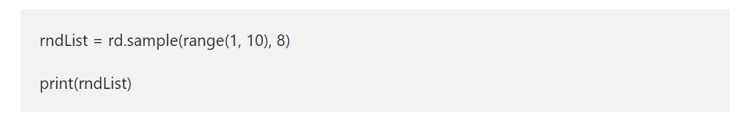
Python Random Number Generator
The random() function generates a number between 0 and 1, and the data type will be float. So the below python number generator example returns a random floating point numbers from 0 to 1.
The randint() function takes two arguments. First argument is the start value, second argument is the stop value. Here, the start is 0 and the stop is n.
The Python random module includes a sample() that allows you to select one or more elements from a list or a tuple. You can use the choice function to select one element from a sequence. To use this, pass in a sequence, along with a sample size (how many elements to sample).

Slide 45
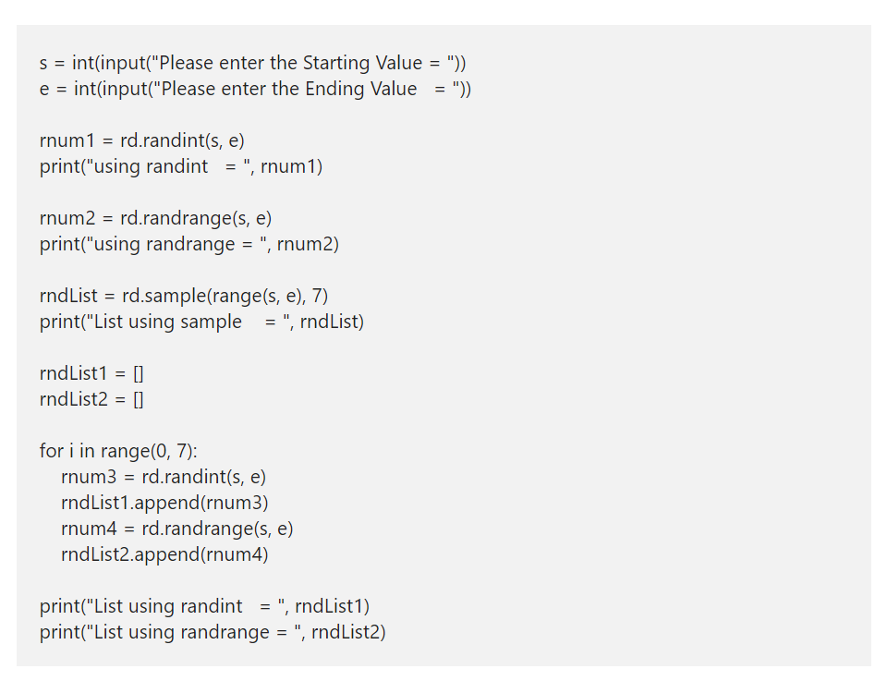

Slide 46
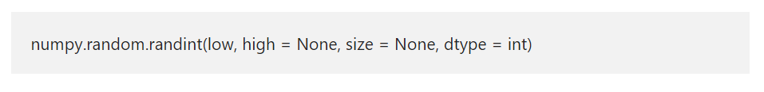
Python numpy random randint
The Python numpy random randint function returns or generates random integer values from the start (low) to end (high). The syntax of the Python numpy random randint function is

